Slide 1
Project : CHATBOT WITH WATSON
Phase 1 -→ Innovation

Slide 2
INTRODUCTION :
Introduce the topic of user experience enhancement through advanced features.Mention the growing importance of Natural Language Understanding (NLU) in technology.

Slide 3
What is the Natural language understanding (NLU)?
Define NLU and its significance in processing human language.Explain how NLU goes beyond simple keyword recognition, understanding context and intent.

Slide 4
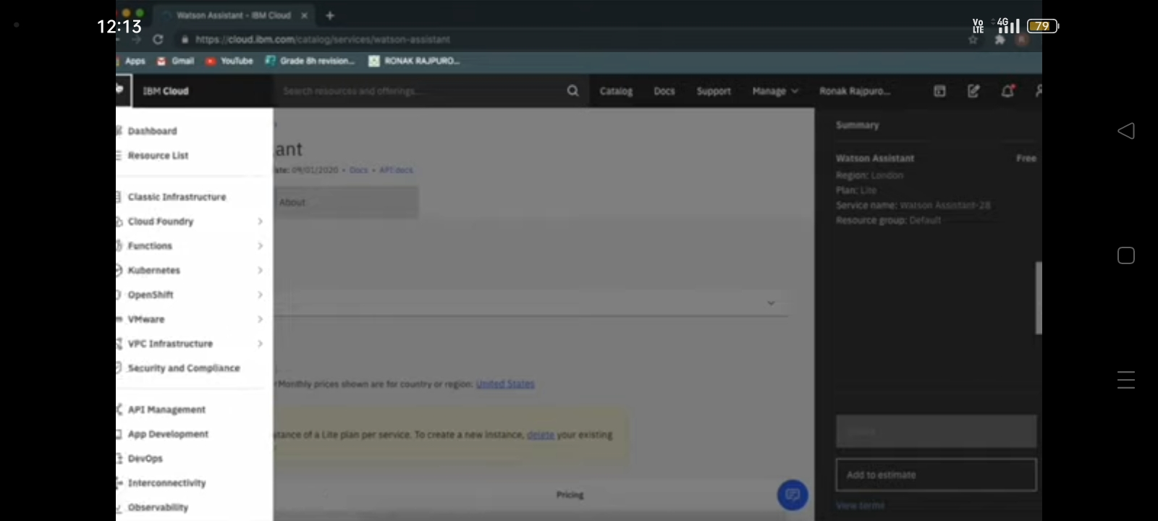

Slide 5
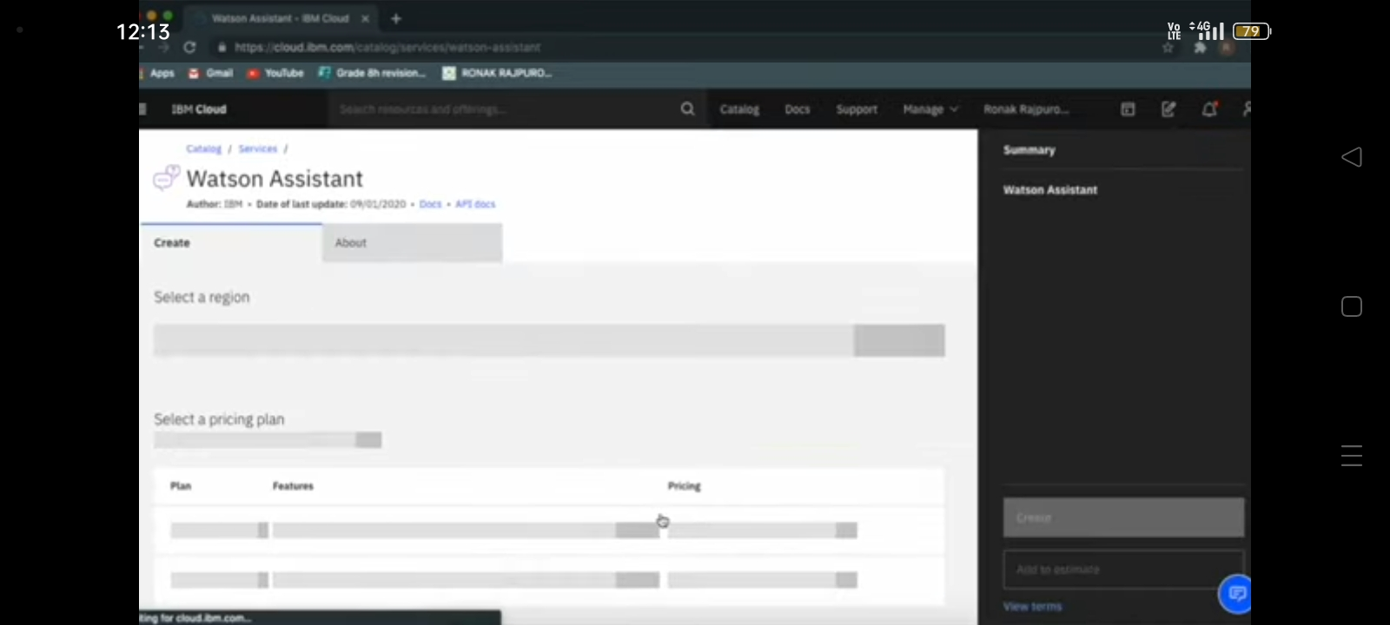

Slide 6
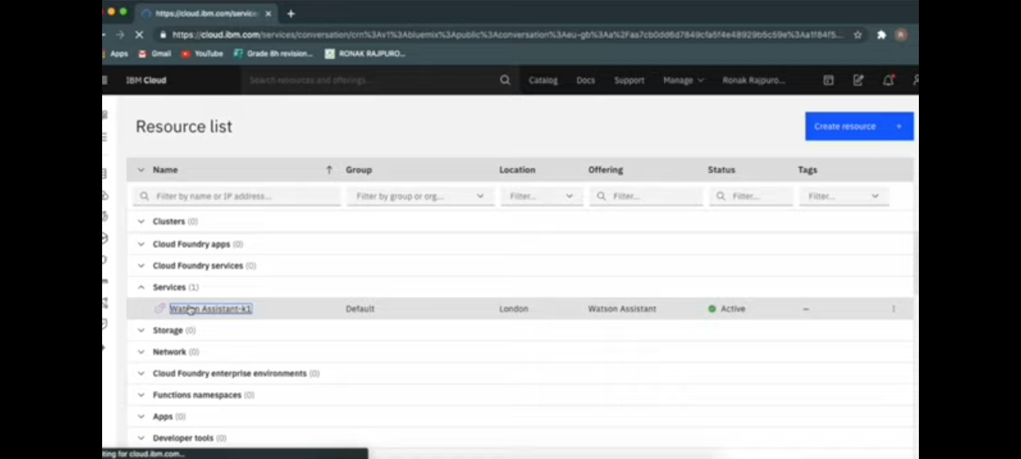

Slide 7
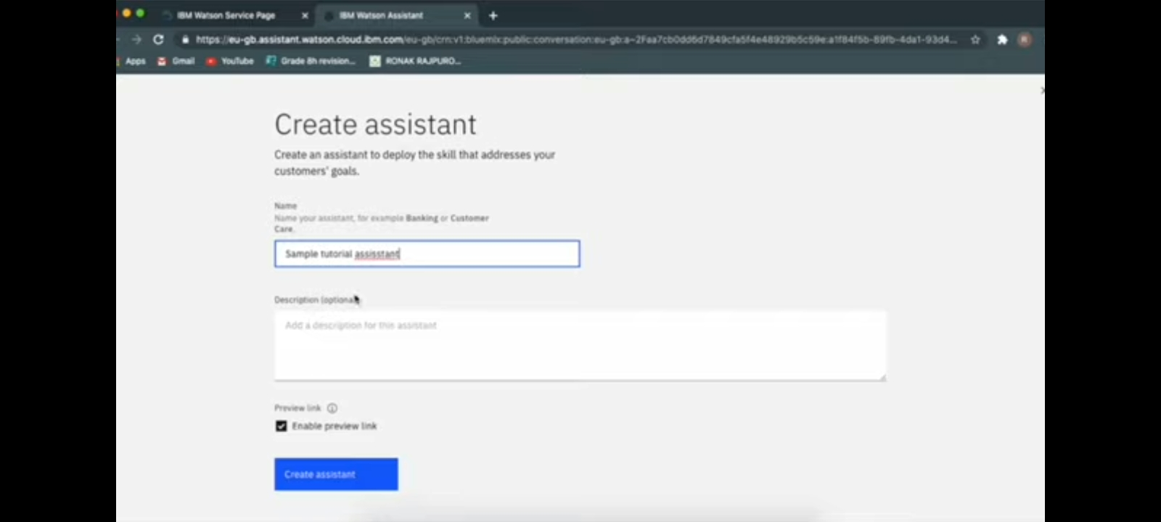

Slide 8
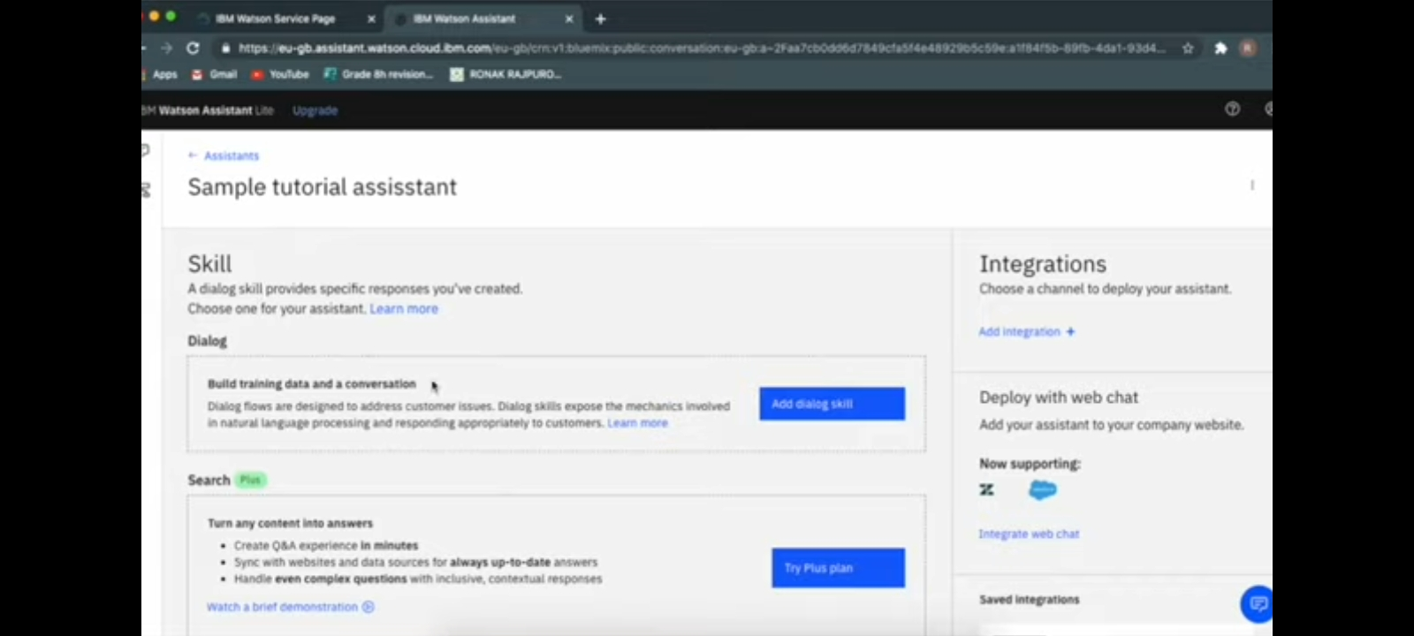

Slide 10
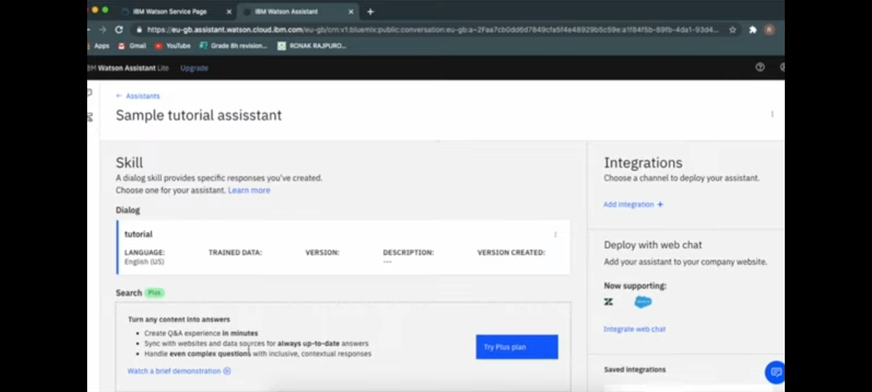

Slide 11
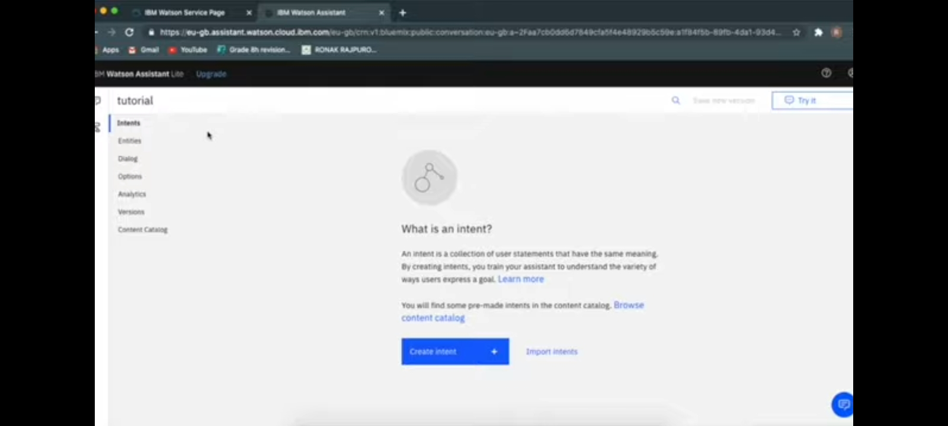

Slide 12
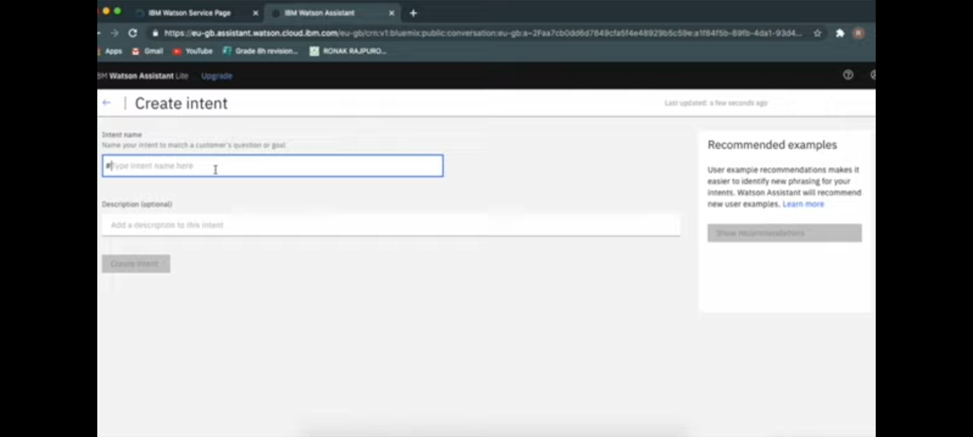

Slide 13
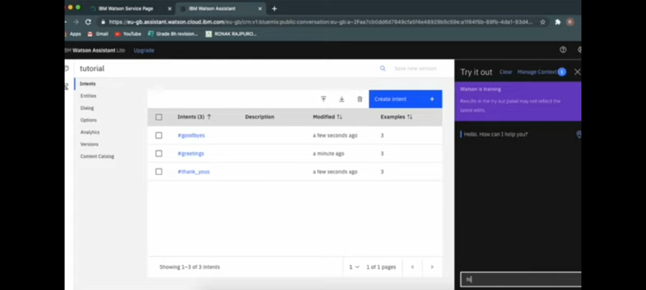

Slide 14
BENEFITS OF NLU
Improved User Experience: Enhancing interactions with intuitive communication.Accurate Intent Recognition: Understanding user needs and queries more precisely.Personalization: Tailoring responses based on individual preferences.
CHALLENAGES AND SOLUTIONS
Challenges in implementing NLU: Complexity, training data, and language nuances.Solutions: Advanced algorithms, machine learning, and continuous training to overcome challenges.

Slide 15
REAL-LIFE APPLICATION
Chatbots and Virtual Assistants: Enhancing customer support and user engagement.Voice Assistants: Enabling natural conversations with devices.Language Translation Services: Providing accurate translations based on context.
FUTURE TRENDS
Discuss upcoming trends in NLU technology, such as emotion recognition and multilingual understanding.How these trends can further enhance user experience.

Slide 16
CASES STUDIES
Present real-world examples of companies successfully implementing NLU.Discuss how these implementations led to improved user satisfaction and business outcomes.
IMPLEMENTATION PROCESS
Steps involved in integrating NLU into existing systems.Importance of thorough testing and iteration for optimal performance.

Slide 17
CONCLUSION
Recap the importance of NLU in revolutionizing user interactions.Emphasize the potential impact on customer satisfaction, loyalty, and businEs
R. Naveen kumar
III –YEAR
CSE DEPARTMENT
UCE-TKY

